Slide 1
COMP 2230
Week 2 - Wednesday

Slide 2
Last time
More on implications
Arguments

Slide 3
Questions?

Slide 4
Assignment 1

Slide 5
Logical warmup
A group of airplanes is based on a small island.
The tank of each plane holds just enough fuel to take it halfway around the world.
Any amount of fuel can be transferred from the tank of one plane to the tank of another while the planes are in flight.
The only source of fuel is on the island, and for the purpose of the problem it is assumed that there is no time lost in refueling either in the air or on the ground.
What is the smallest number of planes that will ensure the flight of one plane around the world on a great circle, assuming that the planes have the same constant ground speed and rate of fuel consumption and that all planes return safely to their island base?

Slide 6
Predicate Logic

Slide 7
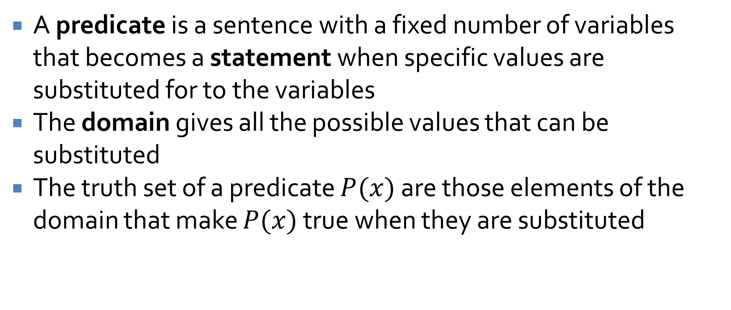
Predicates
A predicate is a sentence with a fixed number of variables that becomes a statement when specific values are substituted for to the variables
The domain gives all the possible values that can be substituted
The truth set of a predicate $P(x)$ are those elements of the domain that make $P(x)$ true when they are substituted

Slide 8
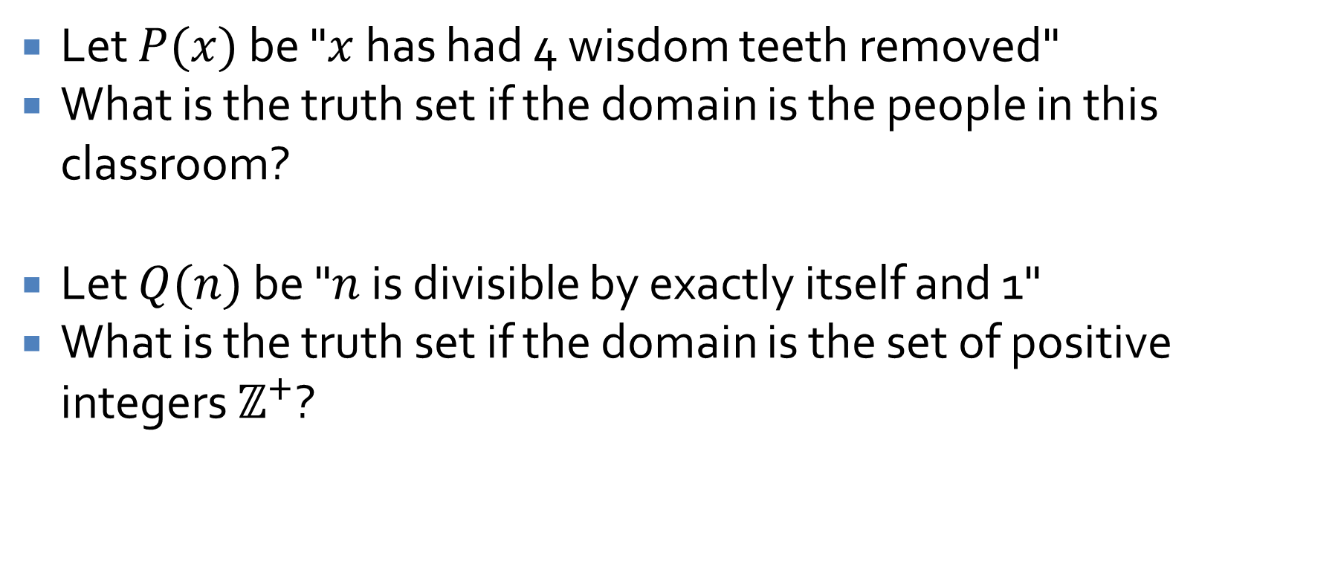
Predicate examples
Let $P(x)$ be "$x$ has had 4 wisdom teeth removed"
What is the truth set if the domain is the people in this classroom?
Let $Q(n)$ be "$n$ is divisible by exactly itself and 1"
What is the truth set if the domain is the set of positive integers $ℤ^{+}$?

Slide 9
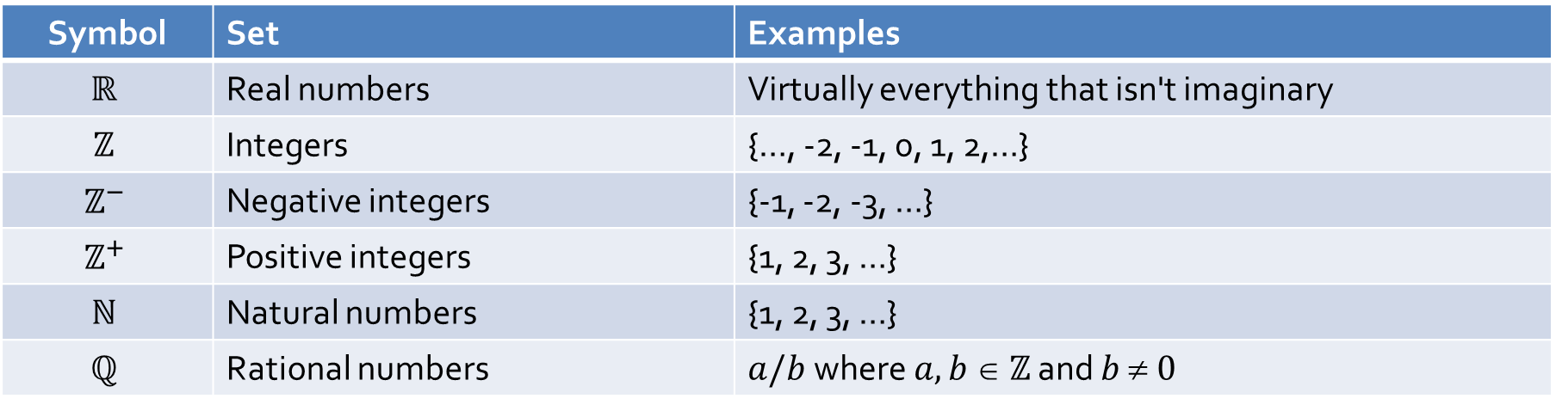
A note about sets
We will frequently be referring to various sets of numbers in this class
Some typical notation used for these sets:
Some authors use Z⁺ to refer to non-negative integers and only N for the natural numbers
Symbol | Set | Examples
$$ℝ$$ | Real numbers | Virtually everything that isn't imaginary
$$ℤ$$ | Integers | {…, -2, -1, 0, 1, 2,…}
$$ℤ^{−}$$ | Negative integers | {-1, -2, -3, …}
$$ℤ^{+}$$ | Positive integers | {1, 2, 3, …}
$$ℕ$$ | Natural numbers | {1, 2, 3, …}
$$ℚ$$ | Rational numbers | $a/b$where $a,b  ℤ$ and $b  0$

Slide 10
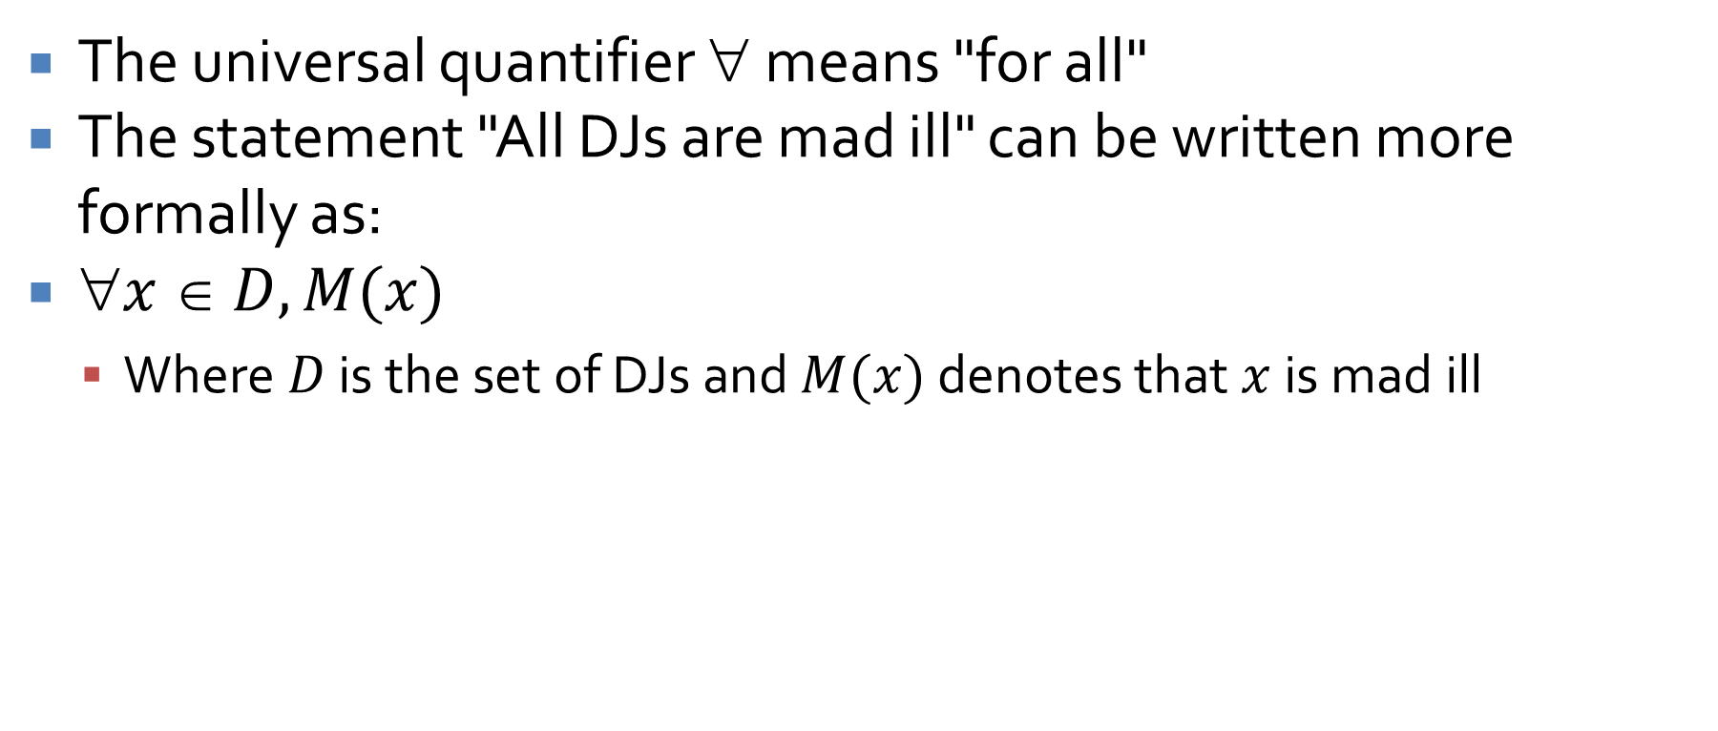
Universal quantification
The universal quantifier ∀ means "for all"
The statement "All DJs are mad ill" can be written more formally as:
$x  D, M(x)$
Where $D$ is the set of DJs and $M(x)$ denotes that $x$ is mad ill

Slide 11
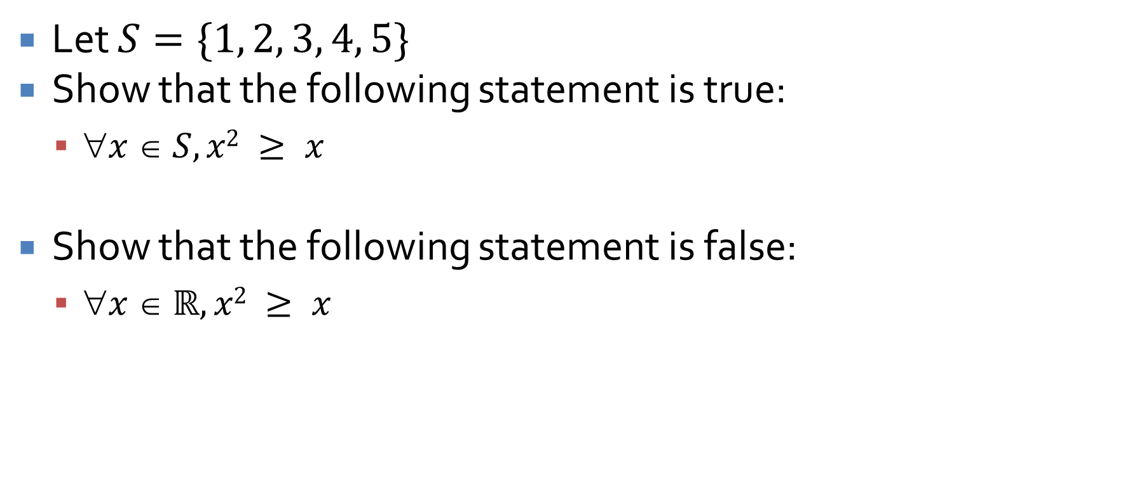
Universal quantification examples
Let $S=\{1, 2, 3, 4, 5\}$
Show that the following statement is true:
$x  S, x2 ≥ x$
Show that the following statement is false:
$x  ℝ, x2 ≥ x$

Slide 12
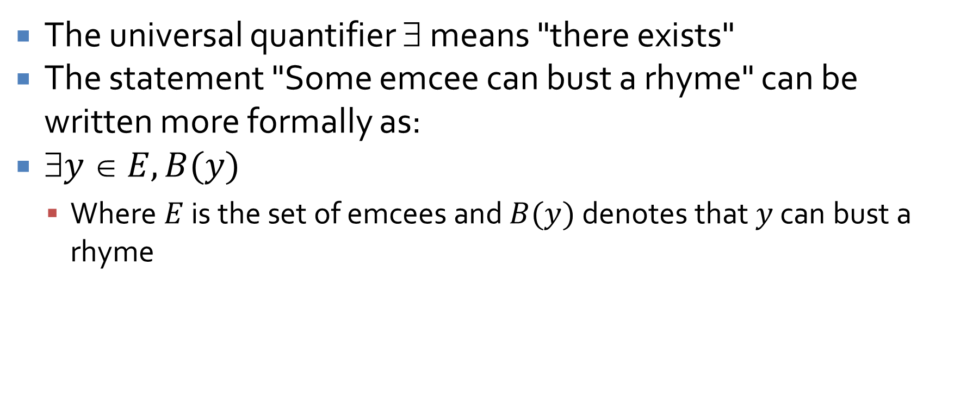
Existential quantification
The universal quantifier ∃ means "there exists"
The statement "Some emcee can bust a rhyme" can be written more formally as:
$y  E, B(y)$
Where $E$ is the set of emcees and $B(y)$ denotes that $y$ can bust a rhyme

Slide 13

Existential quantification examples
Let $S=\{2, 4, 6, 8\}$
Show that the following statement is false:
$x  S, 1/x = x$
Show that the following statement is true:
$ x  ℤ, 1/x = x$

Slide 14
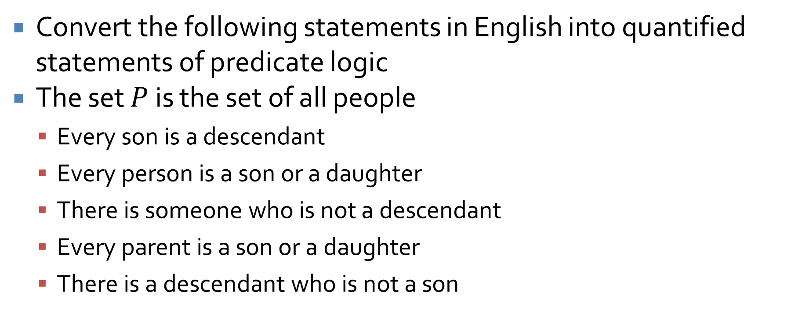
More quantified examples
Convert the following statements in English into quantified statements of predicate logic
The set $P$ is the set of all people
Every son is a descendant
Every person is a son or a daughter
There is someone who is not a descendant
Every parent is a son or a daughter
There is a descendant who is not a son

Slide 15
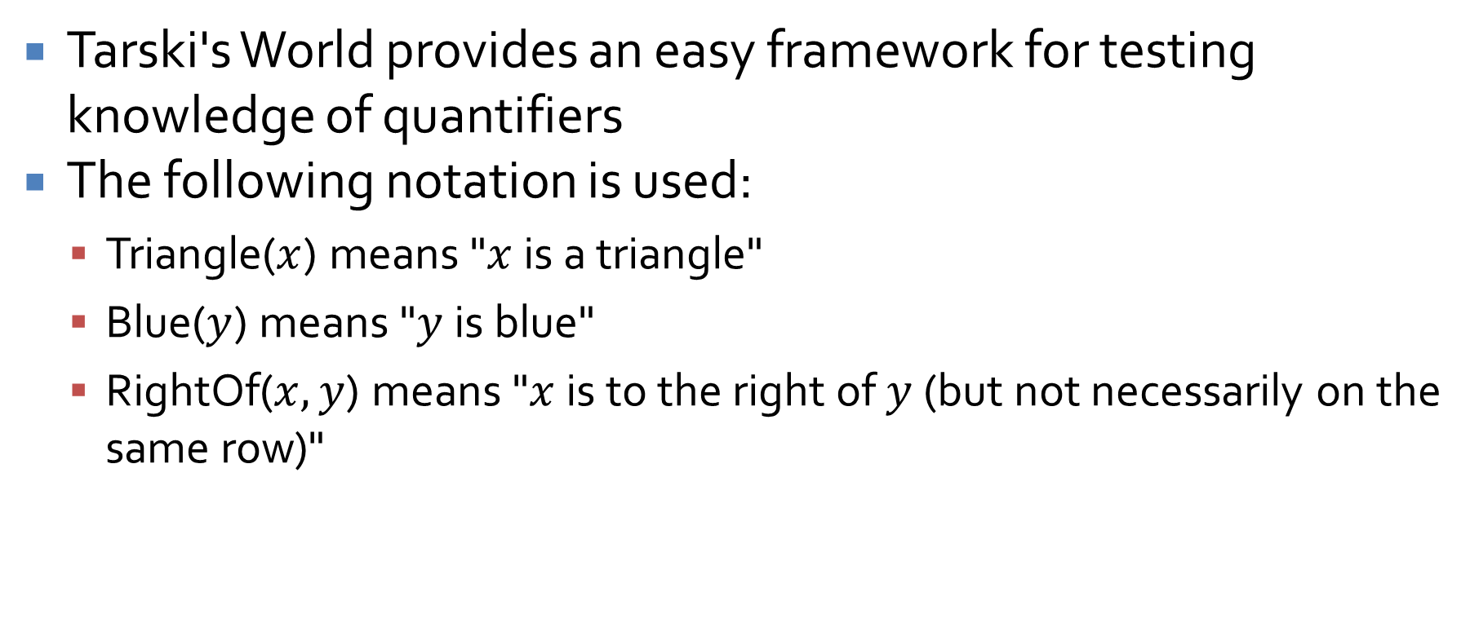
Tarski's World
Tarski's World provides an easy framework for testing knowledge of quantifiers
The following notation is used:
Triangle($x$) means "$x$ is a triangle"
Blue($y$) means "$y$ is blue"
RightOf($x, y$) means "$x$ is to the right of $y$ (but not necessarily on the same row)"

Slide 16
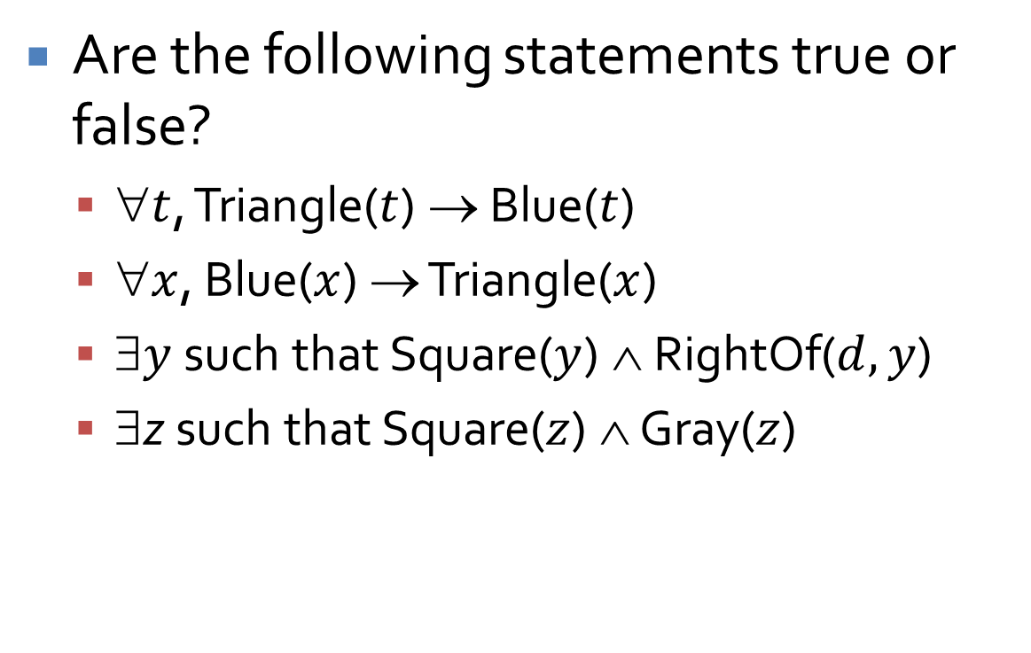
Tarski's World Example
Are the following statements true or false?
$t$, Triangle($t$) → Blue($t$)
$x$, Blue($x$) → Triangle($x$)
∃$y$ such that Square($y$) ∧ RightOf($d, y$)
∃z such that Square($z$) ∧ Gray($z$)
a
b
c
d
e
f
g
h
i
j
k

Slide 17
Negating Quantifiers and Multiple Quantifiers

Slide 18
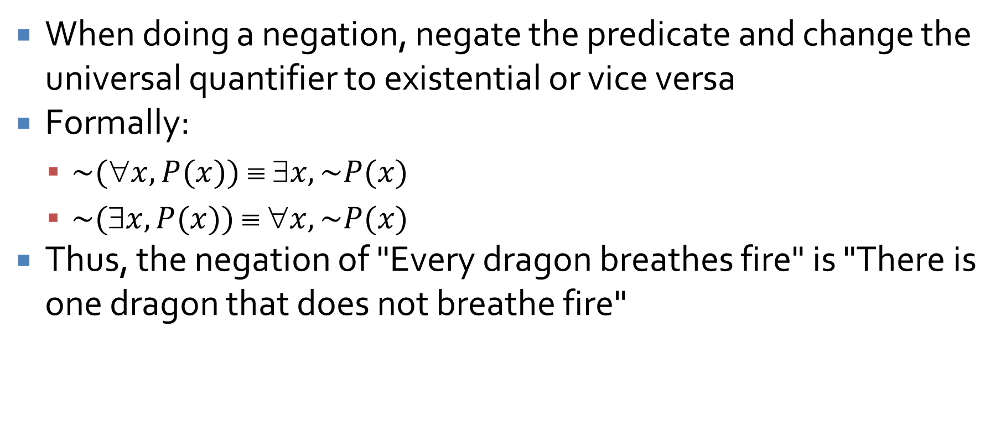
Negating quantified statements
When doing a negation, negate the predicate and change the universal quantifier to existential or vice versa
Formally:
$\sim (∀x, P(x)) ≡ ∃x, \sim P(x)$
$\sim (∃x, P(x)) ≡ ∀x, \sim P(x)$
Thus, the negation of "Every dragon breathes fire" is "There is one dragon that does not breathe fire"

Slide 19
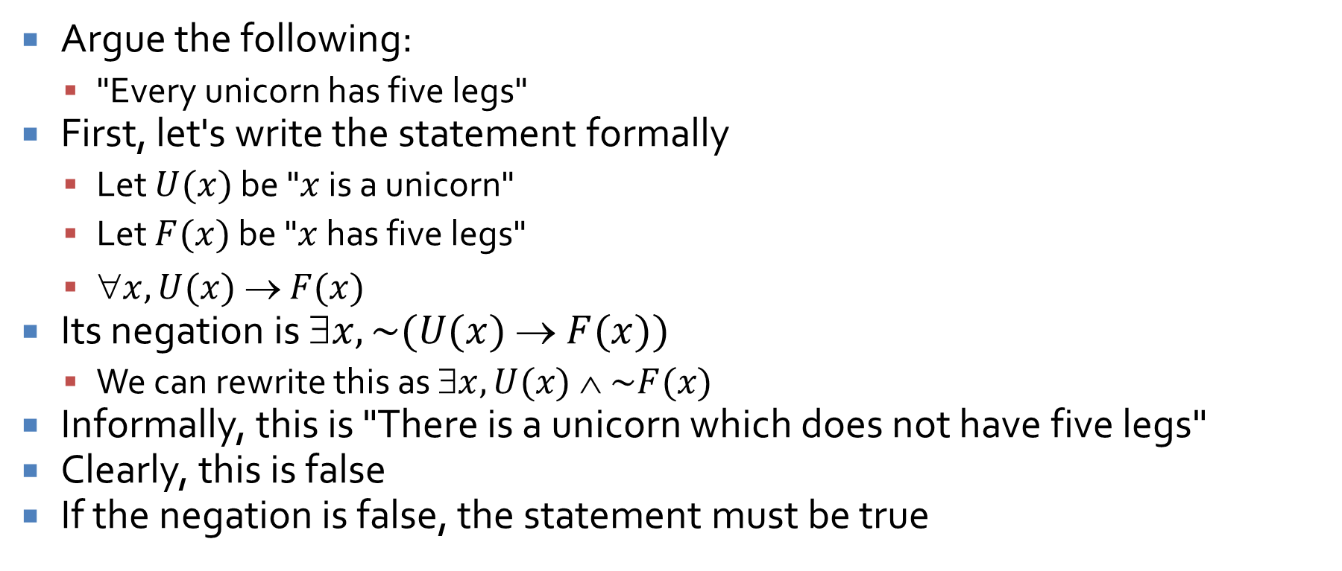
Negation example
Argue the following:
"Every unicorn has five legs"
First, let's write the statement formally
Let $U(x)$ be "$x$ is a unicorn"
Let $F(x)$ be "$x$ has five legs"
$x, U(x)  F(x)$
Its negation is $x, \sim (U(x) → F(x))$
We can rewrite this as $x, U(x) ∧ \sim F(x)$
Informally, this is "There is a unicorn which does not have five legs"
Clearly, this is false
If the negation is false, the statement must be true

Slide 20
Vacuously true
The previous slide gives an example of a statement which is vacuously true
When we talk about "all things" and there's nothing there, we can say anything we want

Slide 21
Multiple Quantifiers

Slide 22
Multiple quantifiers
So far, we have not had too much trouble converting informal statements of predicate logic into formal statements and vice versa
Many statements with multiple quantifiers in formal statements can be ambiguous in English
Example:
"There is a person supervising every detail of the production process."

Slide 23
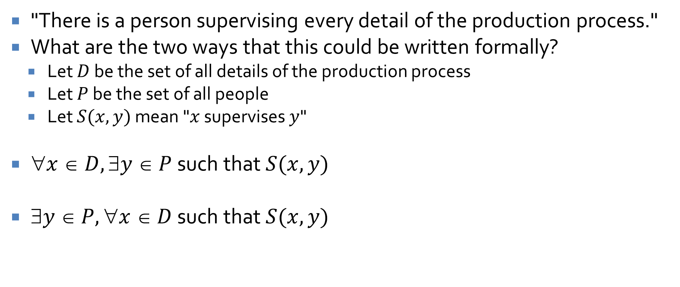
Example
"There is a person supervising every detail of the production process."
What are the two ways that this could be written formally?
Let $D$ be the set of all details of the production process
Let $P$ be the set of all people
Let $S(x,y)$ mean "$x$ supervises $y$"
$x  D, y  P$ such that $S(x,y)$
$y  P, x  D$ such that $S(x,y)$

Slide 24
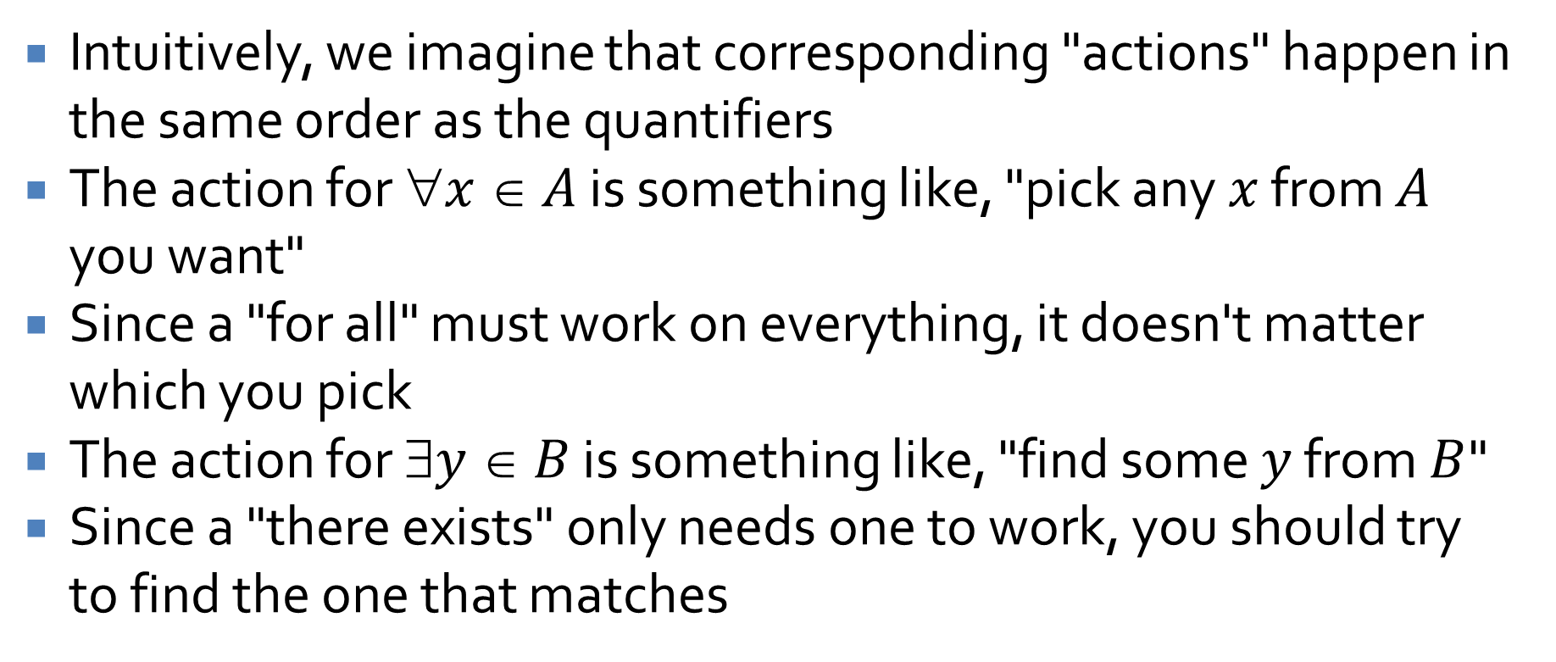
Mechanics
Intuitively, we imagine that corresponding "actions" happen in the same order as the quantifiers
The action for $x  A$ is something like, "pick any $x$ from $A$ you want"
Since a "for all" must work on everything, it doesn't matter which you pick
The action for $y  B$ is something like, "find some $y$ from $B$"
Since a "there exists" only needs one to work, you should try to find the one that matches

Slide 25

Tarski's World Example
a
b
Is the following statement true?
"For all blue items $x$, there is a green item $y$ with the same shape."
Write the statement formally.
Reverse the order of the quantifiers. Does its truth value change?
c
d
e
f
g
h
i
j
k

Slide 26
Practice
Given the formal statements with multiple quantifiers for each of the following:
There is someone for everyone.
All roads lead to some city.
Someone in this class is smarter than everyone else.
There is no largest prime number.

Slide 27
Negating multiply quantified statements
The rules don't change
Simply switch every ∀ to ∃ and every ∃ to ∀
Then negate the predicate
Write the following formally:
"Every rose has a thorn"
Now, negate the formal version
Convert the formal version back to informal

Slide 28
Changing quantifier order
As show before, changing the order of quantifiers can change the truth of the whole statement
However, it does not necessarily
Furthermore, quantifiers of the same type are commutative:
You can reorder a sequence of ∀ quantifiers however you want
The same goes for ∃
Once they start overlapping, however, you can't be sure anymore

Slide 29
Ticket Out the Door

Slide 30
Upcoming

Slide 31
Next time…
Arguments with predicates
Basic proofs and counterexamples

Slide 32
Reminders
Read Sections 3.4, 4.1, and 4.2
Keep working on Assignment 1

